Slide 1
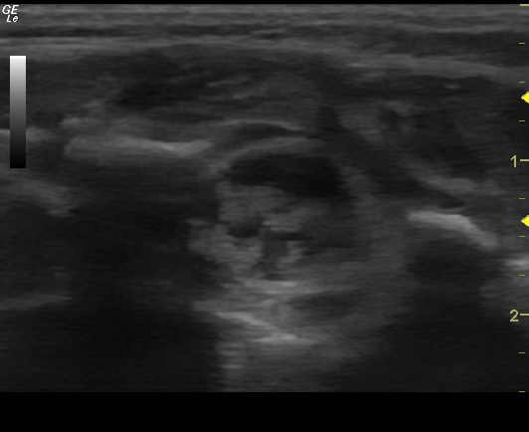
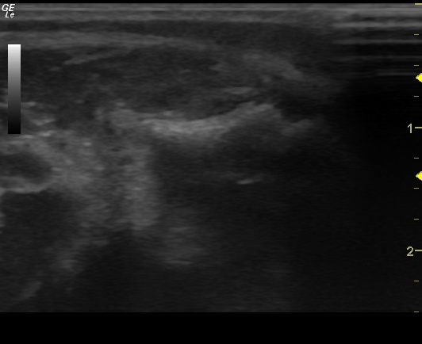
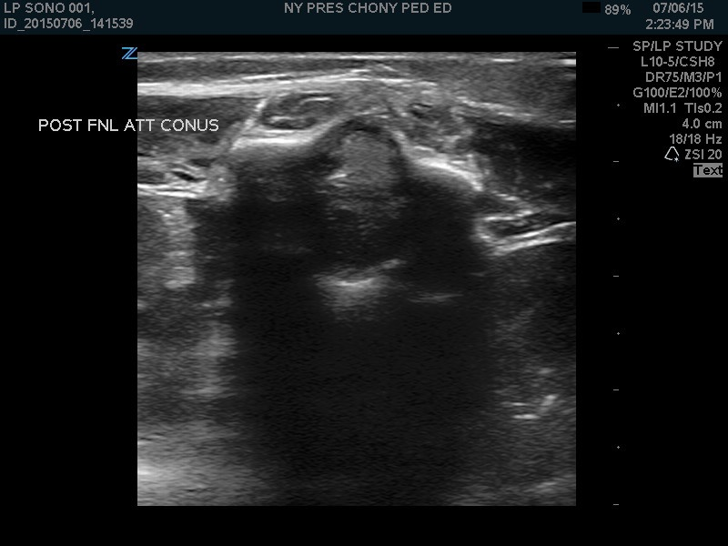
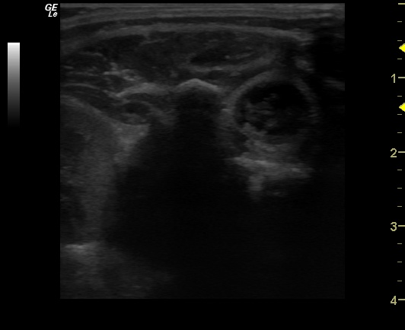
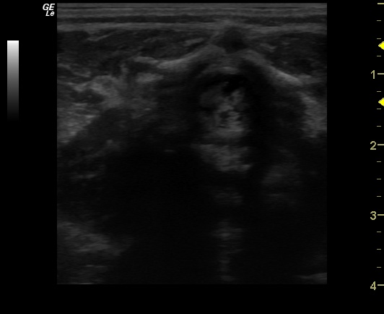
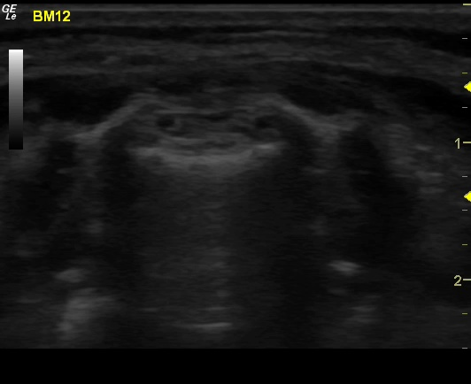
Concept:
Input US Image:
Is the Image Quality Good?
No
Stop and Try Again
Yes
Poor-Quality
Image
There is…
Spinal Cord
Spinal Fluid
Both
Neither

Slide 2
Execution:
Input US Image:
Image Pre-Processing (Normalization, Cropping, Data Augmentation)
Multilabel Classification via Computer Vision Model (ResNet18, Vision Transformer)
Output Predicted Classes (Quality, Spinal Cord/Fluid Present)

Slide 3
Concept:
Input US Image:
Is the Image Quality Good?
No
Stop and Try Again
Yes
Poor-Quality
Image
There is…
Spinal Cord
Spinal Fluid
Both
Neither
Execution:
Input US Image:
Image Pre-Processing (Normalization, Cropping, Data Augmentation)
Multilabel Classification via Computer Vision Model (ResNet18, Vision Transformer)
Output Predicted Classes (Quality, Spinal Cord/Fluid Present)

Slide 4
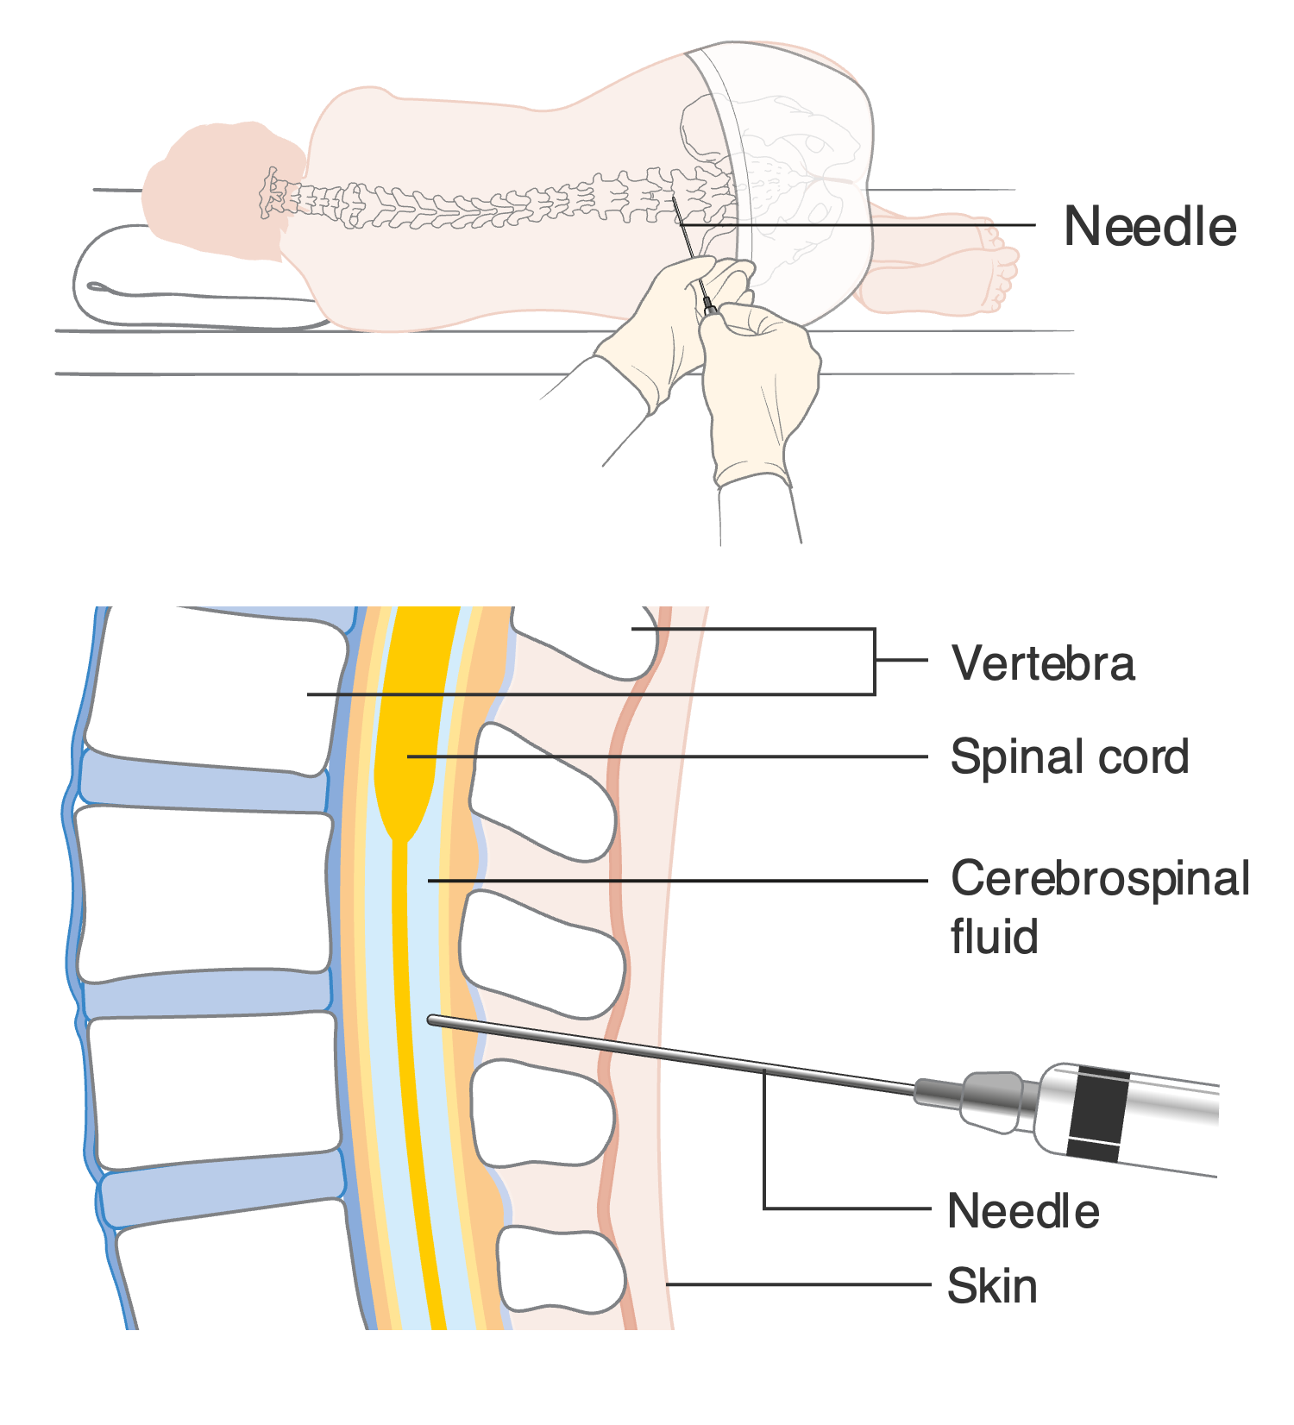
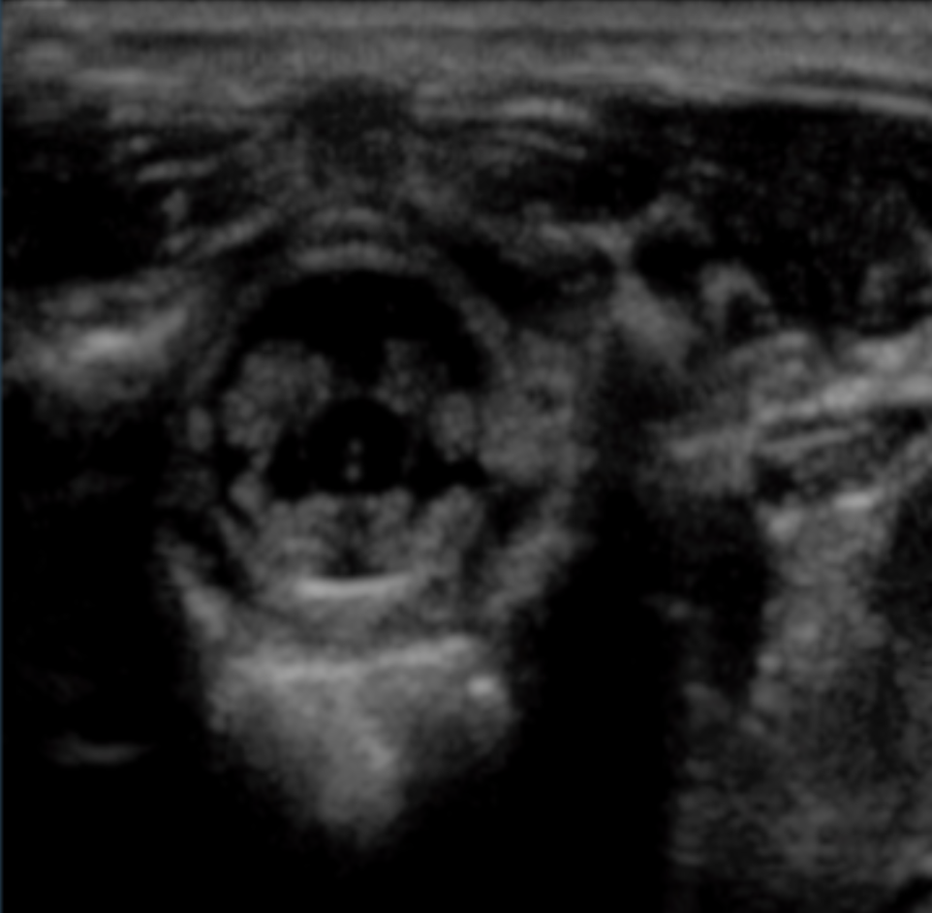
A
B
Spinal Fluid
Spinal Cord

